Slide 1

Ocean Acidification Refugia of the Florida Reef Tract
25º
Derek P. Manzello: Derek.Manzello@noaa.gov
I. Enochs, N. Melo, D. Gledhill, E. Johns, J. Hendee, R. Wanninkhof

Slide 2
Ocean Acidification
Pressing Need:
  Spatiotemporal variability of carbonate chemistry, especially in coastal environment

Slide 3
Florida Reef Tract
“Inimical water hypothesis”
    -Ginsburg and Shinn (1966)
Well-publicized decline since 1980s
Coral cover about 5%, except for inshore patch reefs (about 20-25%)
Notes:
Before we dive into the carbonate chemistry data, I’d like to bring you up to speed on the Florida Reef Tract. Here is a very coarse benthic map from 2005. What they define as ‘coral’ or reef habitat is this red line. All this green is seagrass. What this map doesn’t show well are the inshore patch reefs that dot the upper and lower keys in between this offshore red line and mainland keys.
CLICK
The Keys have been pretty well studied and the coral reefs are well documented. The best developed reefs are offshore of the upper Florida Keys, off Key Largo here. There are also some very well developed reefs offshore of the lower Keys. Looe Key sits here and is probably the most visually spectacular reef in the entire Florida Keys. The tortugas also have good reef development. In the middle Keys, reef development is extremely poor. This was ‘coined’ the inimical reef hypothesis by Bob Ginsburg and Gene Shinn – the idea here being the exchange of ‘inimical waters’ from Florida Bay through the wide channels in the middle Florida Keys is responsible for the poor development of reefs offshore.
CLICK
Over the past 30 years, the FRT has undergone a pretty well publicized decline.
CLICK
Coral cover has declined pretty severely and averages about 5% on these reefs here in red. This is not true, however, on the inshore patch reefs. Here coral cover can be very high and averages about 25%.
CLICK
My colleage Diego Lirman did an excellent study where he showed that coral cover decreases significantly with distance from shore.

Slide 4
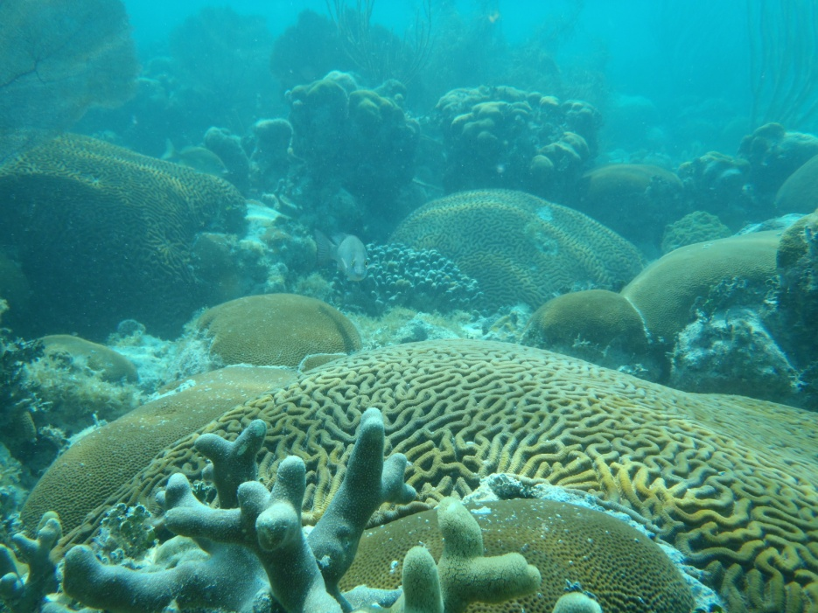
“Coral cover decreases significantly with increasing distance from shore.”
  -Lirman and Fong (2007, Mar. Poll. Bull.)

Slide 5
Seasonal Variability of Florida Reef Tract
SPRING
2011
PLoS One (In Press)
Notes:
Here is a snapshot of the spatial variability in carbonate chemistry for the Florida Reef Tract. These are data from April 2011 where water samples were collected and analyzed for dissolved inorganic carbon (or Total CO2) and total alkalinity. With these data and temperature and salinity, pCO2 and the saturation state of aragonite were calculated.
What you’ll notice is that inshore waters are depleted in both TCO₂ and TA relative to offshore. The depletion of TCO₂ is sufficient to elevate the aragonite saturation state values significantly as you go closer to shore relative to offshore at all sites. The highest saturation state values occur in the upper Keys.

Slide 6
Seasonal Variability of Florida Reef Tract
LATE FALL
2011
PLoS One (In Press)
Notes:
In Late Fall, the trend we saw in Spring is reversed. The increase of inshore TCO₂ in autumn depresses aragonite saturation state relative to offshore, such that pCO2 increases and aragonite saturation state decreases closer to shore. These observations are interesting, but lead us to more question. For instance, what is the net magnitude and direction of this gradient – put simply, do inshore sites experience higher or lower saturation states overall when you consider the entire seasonal cycle?

Slide 7
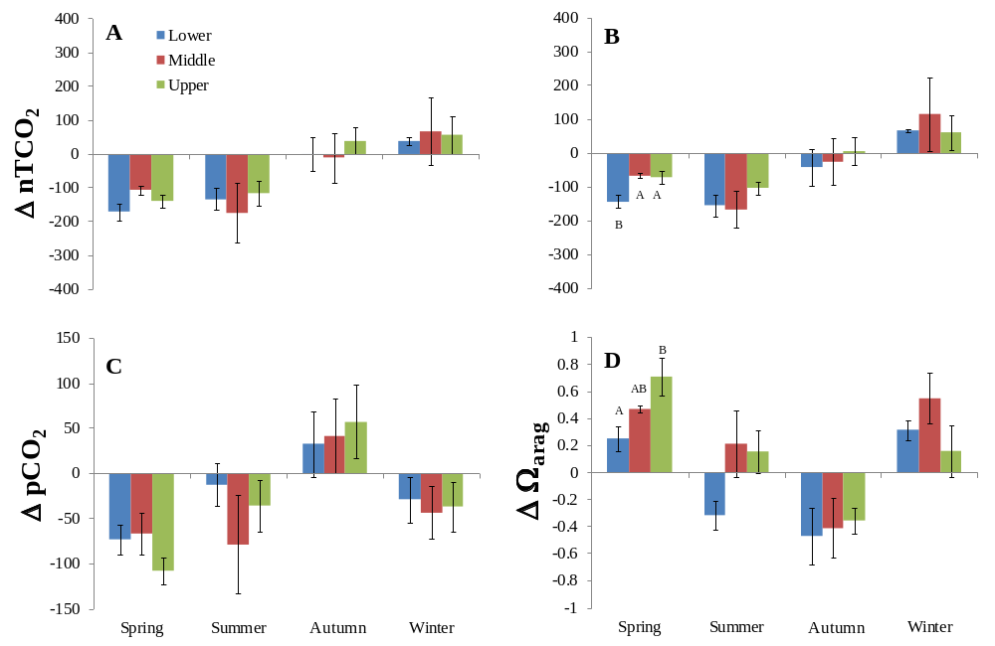
Magnitude and Direction of Gradient By Season
Sum across all seasons, Σ
Site | ΣΔnTCO₂ | ΣΔnTA | ΣΔpCO₂ | ΣΔΩ_{arag}
Upper | -162.5 | -111.2 | -125 | 0.66
Middle | -228.0 | -147.3 | -149 | 0.81
Lower | -271.5 | -277.0 | -84 | -0.23
PLoS One (In Press)
Notes:
To address this question, we undertook carefully stratified sampling the carbonate chemistry at paired inshore and offshore sites in the upper, middle, and lower Florida Reef Tract across all seasons over 3 years. Here we have the mean gradient for the four carbonate parameters across all seasons by the upper, middle, and lower florida Reef tract. The delta value here is the difference between inshore and offshore values of (A) salinity normalized TCO2, (nTCO₂), (B) salinity normalized alkalinity (nTA), (C) pCO₂, and (D) aragonite saturation state for the upper, middle, and lower Keys plotted by season. The UK had the greatest magnitude of delta aragonite saturation, due primarily to very high inshore saturation state values in spring --- the mean aragonite saturation state for the UK inshore site was 4.69, which is greater than the tropical average during preindustrial times.
CLICK
To determine the net effect across all seasons, we took the sum of the mean delta values by season, and this is represented by Sigma. Negative values mean that overall, values are lower inshore, whereas positive values indicate overall values are greater inshore and vice versa. What we see is that there is a net drawdown in TCO2 and TA and pCO2 for all sites. The increase of inshore aragonite saturation during the spring and summer is greater than its depression during autumn for both the UK and MK.

Slide 8
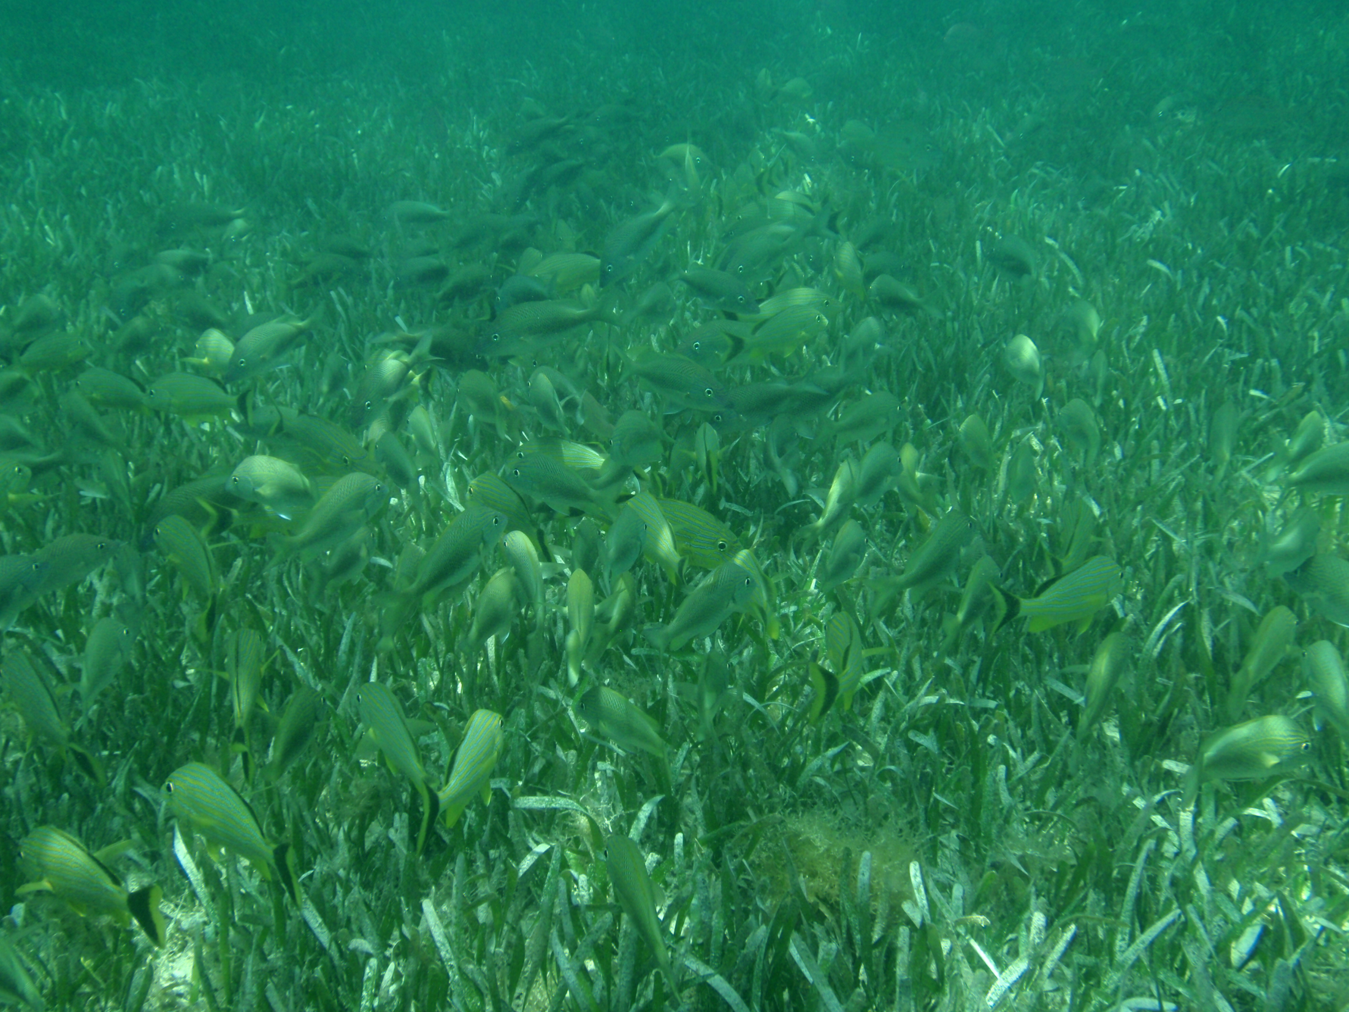
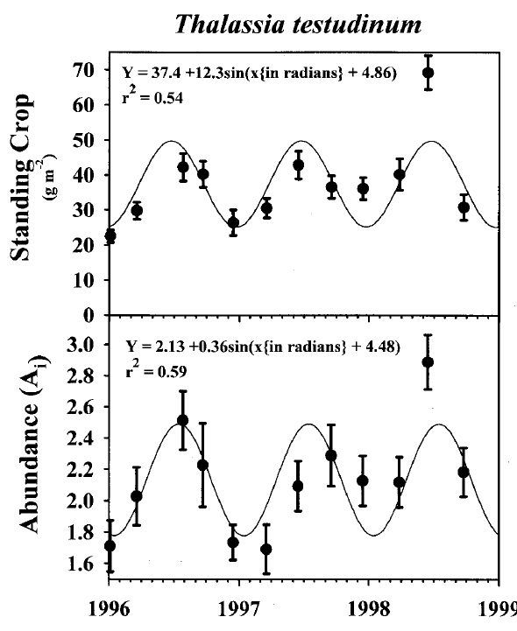
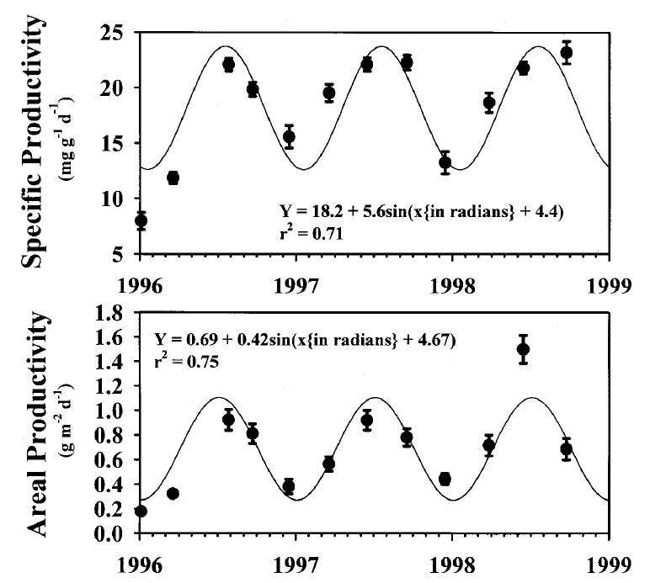
Seagrass and Macroalgae Abundance and Productivity
Seagrass Standing Crop and Abundance
Productivity
Same trend for Macroalgae:
-Max abundance in Spring/Summer,
-decay in Fall/Winter
Lirman and Biber (2000, Bot. Mar.)
Collado-Vides et al. (2005, J. Phycol.)
Max, June
Min, January
Max, July
Min, January
Fourqurean et al. (2001, Marine Biology)
Notes:
So what is causing this trend? When you dig into the carbonate chemistry, the large elevation in saturation state is due to large declines in total CO2, thus this suggests this is primarily a result of primary production. As you go from the offshore reef tract to shore, seagrasses are the dominant benthic type.
-CLICK-
Likewise, the dominant species of seagrass, Thalassia testudinum, or turtle grass reach their peak standing crop and abundance in June, and their peak productivity in July. Minimum values for these occur in January.
CLICK
This same trend occurs in macroalgae in the Florida Keys, where they increase in abundance from the spring to summer, peaking in July, and then decline to a minimum in January/February.

Slide 9
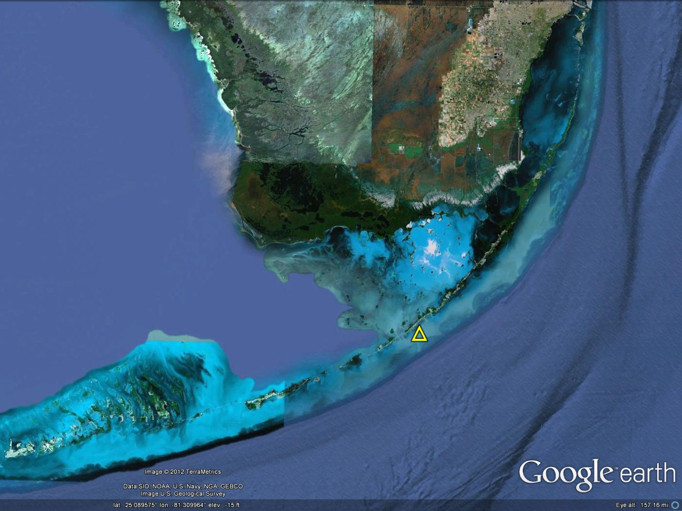
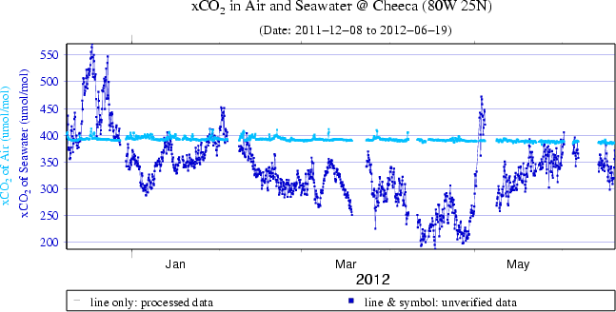
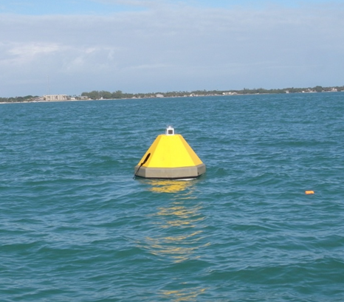
High Resolution CO₂ Time-Series
Cheeca Rocks: Inshore Patch Reef
Miami
Cheeca Rocks
http://www.pmel.noaa.gov/co2/story/Cheeca+Rocks
Key West
MAP-CO₂
Notes:
We recently established a climate monitoring site and deployed a MAPCO2 buoy at one of these inshore patch reefs in the Florida Keys. The MapCO2 buoy measures the mole fraction or concentration of CO2 in both seawater and the atmosphere every three hours.
-CLICK-
Mole Fraction of CO2 in air and water (similar to pCO2). Light blue line is CO2 in atmosphere, a little less than 400 micrmol per mol. Dark blue is CO2 in seawater. This is confirmation of the strong drawdown of CO2 at these inshore sites. This also shows that this drawdown in pCO2 persists across the entire diurnal cycle and isn’t erased at night when photosynthesis is shut off.

Slide 10

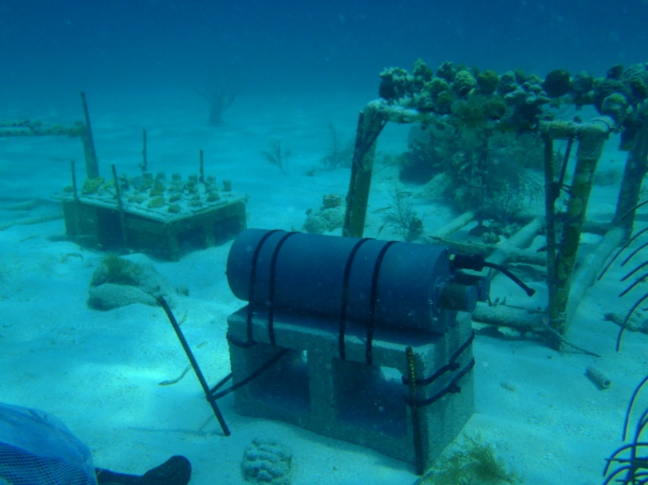
SeaFET pH
Miami
Key West
Notes:
We also deployed SeaFET pH sensors to explore the diurnal varability in pH at the upper Keys inshore and offshore reef site.

Slide 11
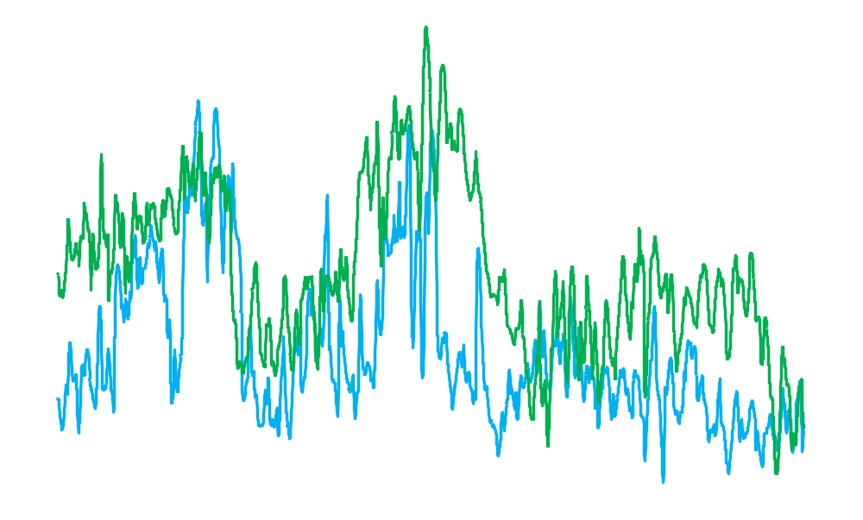
High Resolution pH Time-Series
 | INSHORE | OFFSHORE
Mean (± SEM) | 8.138 (0.0011) | 8.087 (0.0010)
Min | 8.008 | 8.003
Max | 8.297 | 8.250
Range | 0.288 | 0.247
pH
Notes:
Here are pH Measurements every 30 min from April 4 to May 19, 2012. This shows a large diurnal variability at both the inshore and offshore site, but that this variability is essentially no different as the variance is for all practical purposes the same. Mean pH at the inshore site for this time period was 0.05 units greater than offshore.

Slide 12
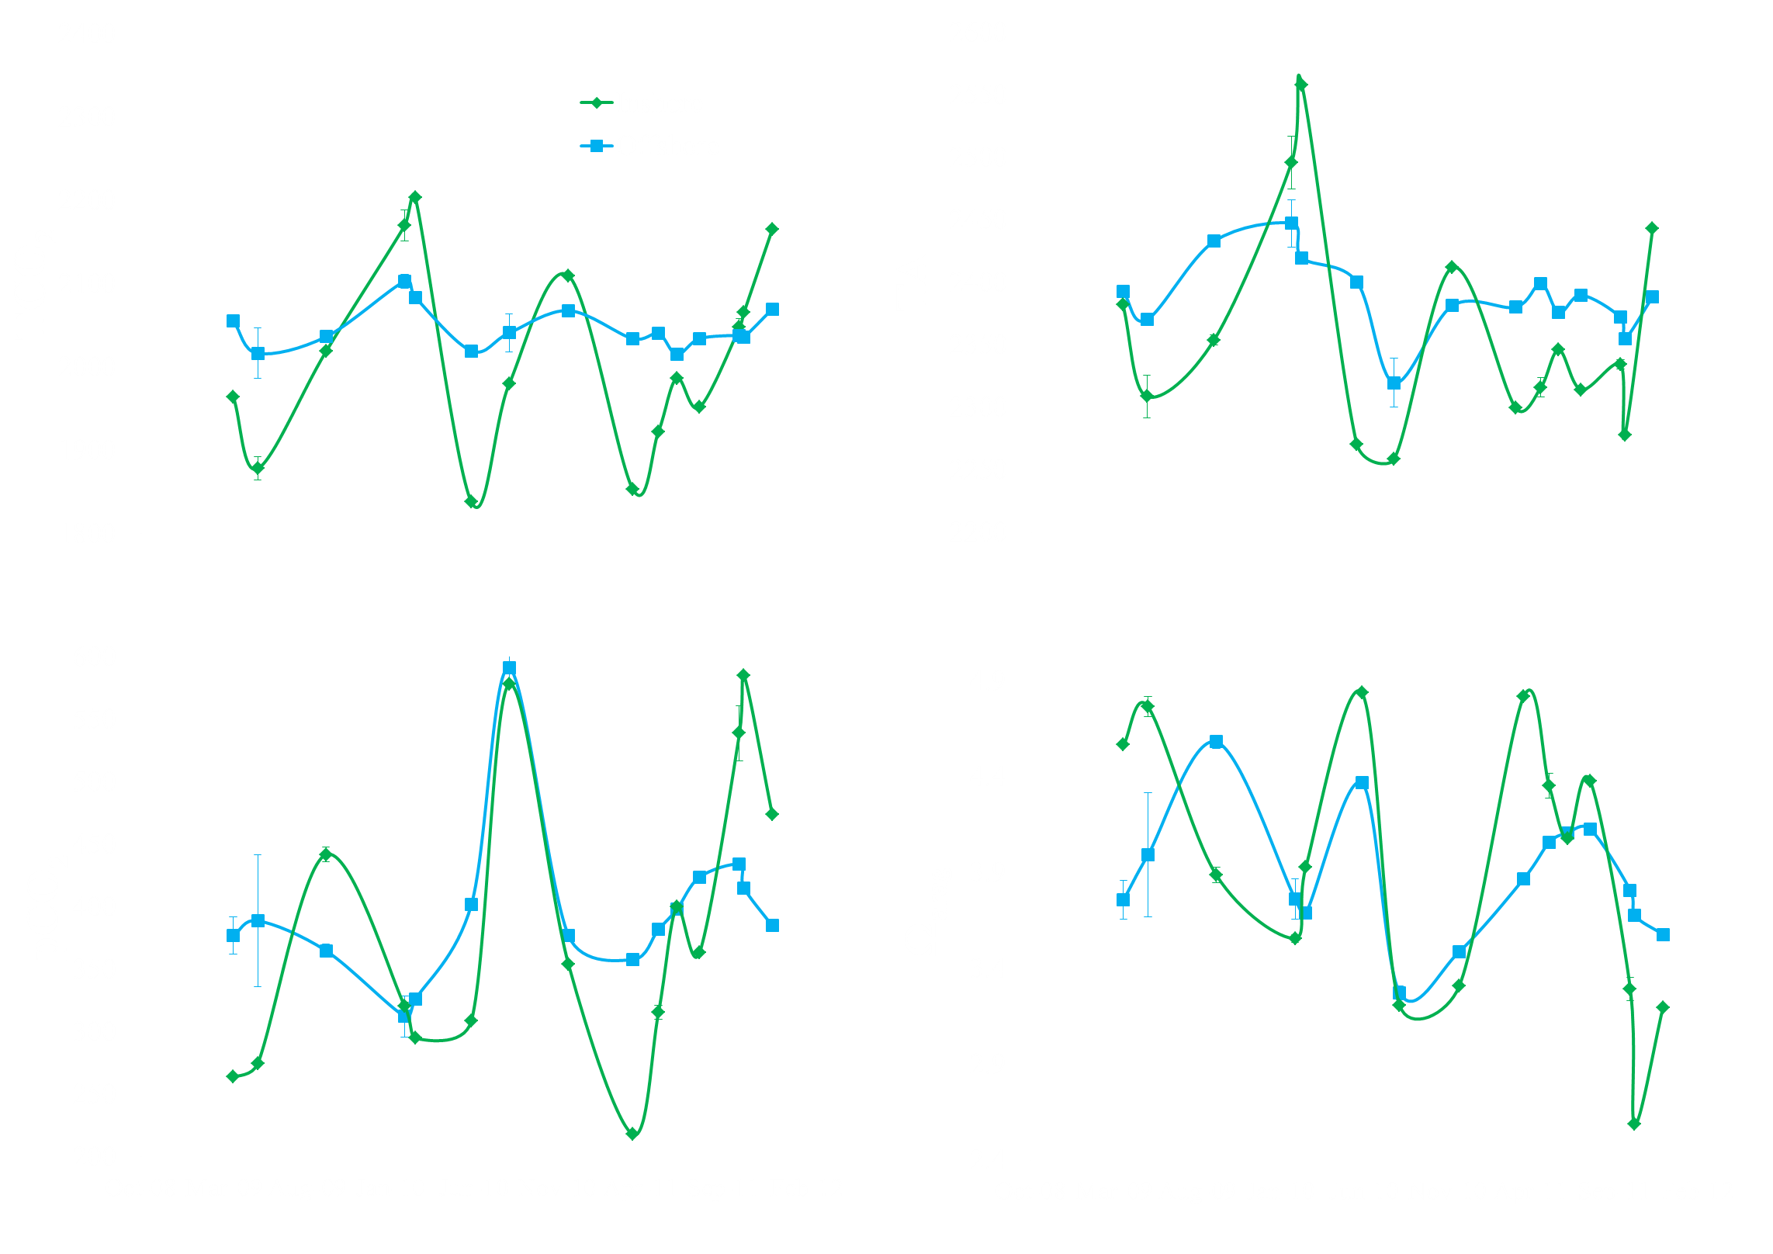
Time-Series: Upper Keys, 2009-2011
Cold-water mass coral mortality
Windy
Low salinity event
Notes:
Before we get into the growth data, lets look briefly at the time-series data of CO2 from these sites. Here is the data from the upper Keys sites – I also indicate the offshore sites in blue and the inshore sites in green because this roughly approximates the water color at these sites.
Trend of CO2 uptake at inshore site during Spring and early summer clearly evident in TCO2 plot. There was a large seasonal amplitude for both the inshore TCO₂ and TA that was not apparent offshore. Offshore site was more stable. This uptake of CO2 corresponds with lower pCO2 and higher aragonite saturation. Let me point out some interesting events and how they impacted the carbonate chemistry.
CLICK
First, in January 2010 there was record cold weather in South Florida. This resulted in catastrophic mass mortality of many inshore patch reef sites. In fact, this mortality was orders of magnitude greater than any of the documented warm water bleaching events to hit the Keys. The inshore site here was seriously impacted with coral mortality ranging from 83-100% on four species of corals I was monitoring growth on. You’ll note that the samples taken immediately after the mortality, there was an enrichment in CO2, but perhaps more interesting is this spike in total alkalinity. This suggests that there was dissolution occurring after the event. This was likely a result of the localized CO2 enrichment within the decaying, moribund tissues causing abiotic dissolution.
CLICK
The next interesting thing is that there was windy and overcast conditions when sampling was done in August 2010. During this time there was a spike in pCO2 and unseasonably low aragonite saturation and no difference between inshore/offshore sites. Strong wind-driven mixing appears to erase this gradient.
CLICK
Lastly, and recently, there was very high rainfall in south Florida in October of this past year. Low salinity water was observed Keys-wide at the inshore sites and correlated with a spike in pCO2 and large depresssion of aragonite saturation. Just in the past month, TS Debby caused cloudy and rainy weather for over a week in South Florida and we saw a spike in pCO2 at the MapCO2 buoy at Cheeca Rocks.

Slide 13
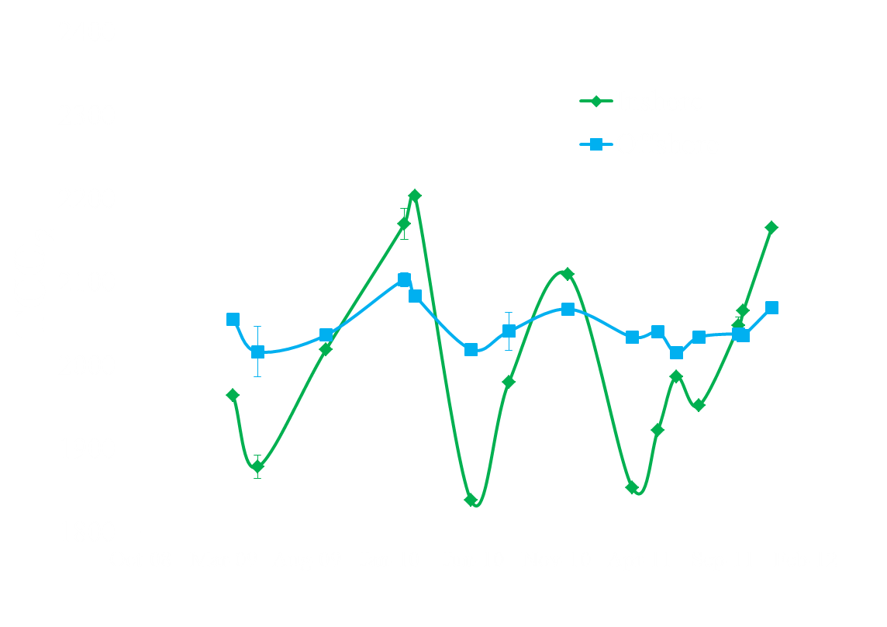
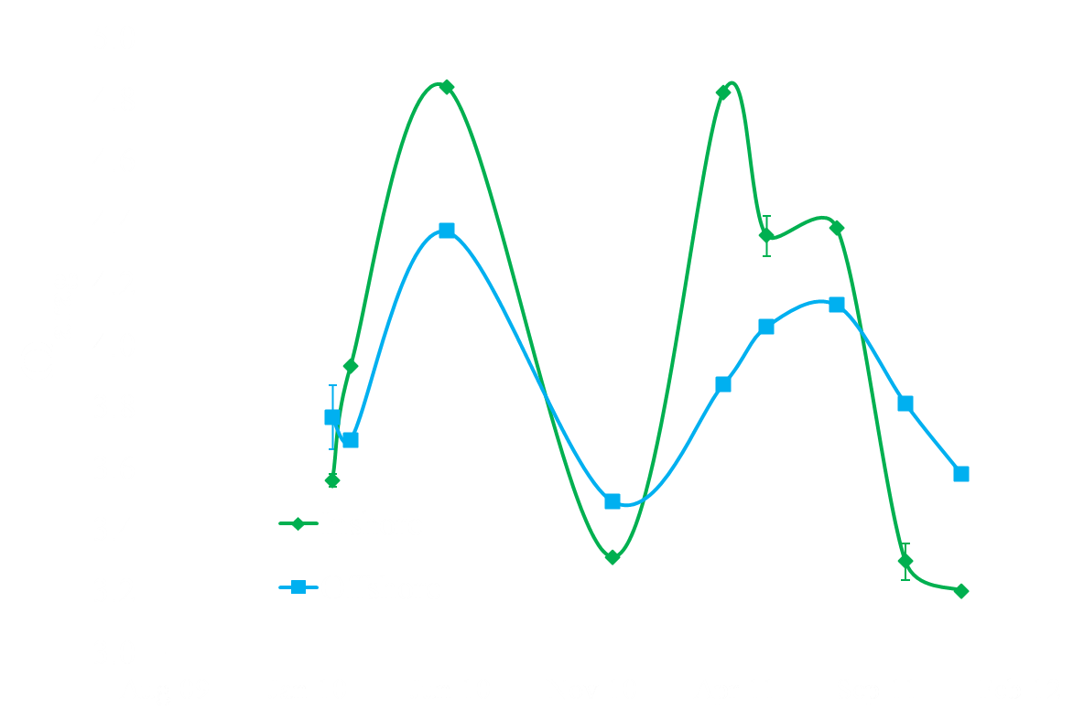
Seagrass OA Refugia (SOAR) hypothesis
Notes:
This figure illustrates the OA refugia hypothesis in a nutshell.
CLICK
What we see is a strong drawdown of total CO2 during the Spring and Summer. This is due to seasonally high productivity in seagrasses and macroalgae that occur at this time. This drawdown in dissolved inorganic carbon is higher than the enrichment which occurs during the fall and winter. Not that this first year is coincident with the cold-water mass mortality of corals nearshore, and in the last year, this is coincident with the low salinity event. In the middle is more of the normal condition, and you’ll notice the DIC enrichment is much less than the spring/summer drawdown.
CLICK
This is apparent in the aragonite saturation data.

Slide 14
Conclusions I
Seagrass and macroalgal photosynthesis cause large CO₂ drawdown close to shore, especially in upper, middle keys
Notes:
Seagrasses and macroalgae drawdown a significant amount of DIC in the Florida Keys. I think seagrasses are the most significant because they bury a fair amount of their carbon in their roots and rhizome structures, whereas macroalgae are more ephemeral – thus the majority of the carbon they fix likely ends up back in the water column either via grazing or microbial breakdown, whereas seagrasses are burying up to 50% of their production in their roots and rhizomes which lay within sediments. Seagrasses act as a CO2 sink and are net autotrophic. Net autotrophy within seagrass meadows is due, in part, to low levels of herbivory, as < 20% of seagrass productivity is consumed by herbivores. Another interesting thing is that seagrasses are carbon limited, whereas macroalgae are able to effectively utilize the abundant HCO₃⁻ in seawater for photosynthesis [49]. Consequently, seagrass productivity is expected to be stimulated with OA [49-52], whereas macroalgae, already carbon-saturated, should not exhibit any increases in photosynthesis or growth [49]. For example, seagrasses exposed to high-CO₂ conditions for 1 yr had increased reproduction, rhizome biomass, and vegetative growth of new shoots, which could represent a potential positive feedback to their ability to serve as OA refugia [51]. These results have implications for other calcifying organisms other than corals. Seagrasses, unlike shallow coral reefs, are an ecosystem that is not limited to the warm tropical latitudes. As such, the potential for seagrasses to locally buffer OA within coastal zones may be much greater than what is considered here and could even increase over time.
Click
Click
The most obvious caveat to this is that where you see the largest CO2 drawdown is also where you have the most extreme temperatures, thus only those environments which are shielded from thermal extremes might be OA refugia.
Click
It is interesting that the resilient reefs on the FRT actually fall within this OA refugia category.

Slide 15
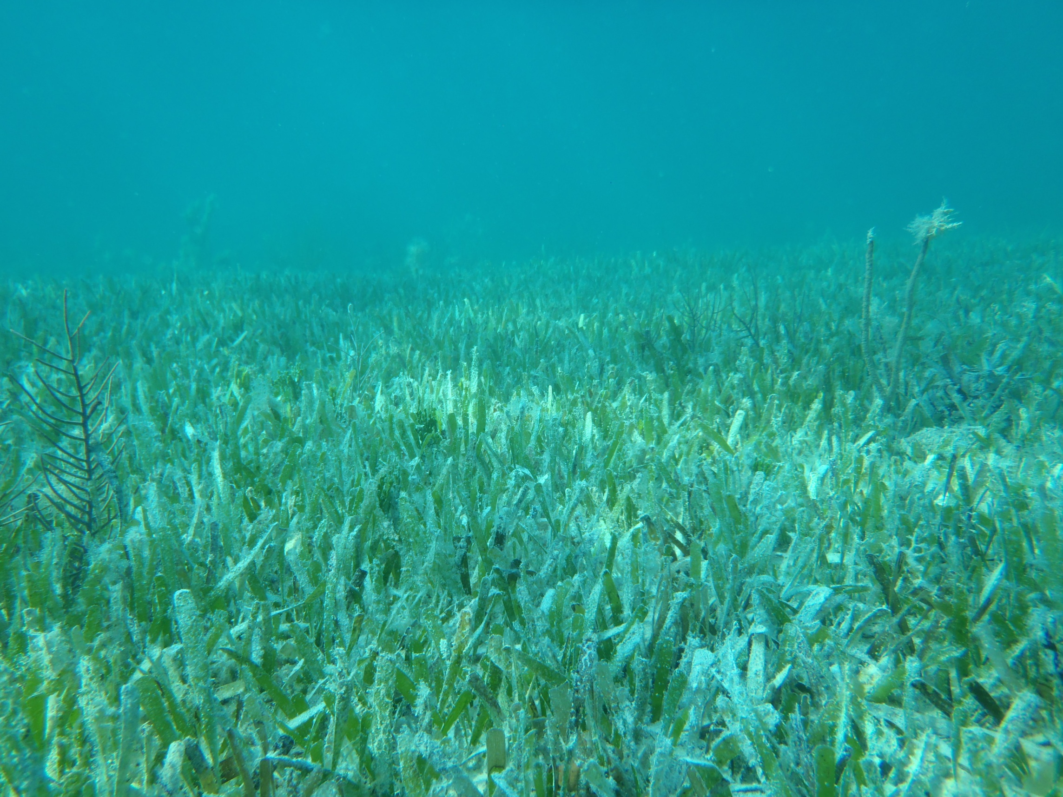
Seagrass 101
Bury up to 50% of production in roots/rhizomes and are net autotrophic (Duarte et al. 2010, Glob. Biogeochem. Cycl.)
CO₂ sinks (Duarte et al. 2011, Ocean Coast Mgt.)
Carbon limited, whereas macroalgae are not (Beer and Kock 1996, MEPS)
Productivity stimulated with OA (Zimmerman et al. 1997, MEPS; Palacios et al. 2007, MEPS; Jiang et al. 2010, Int. J. Plant Biol.)
  High-CO₂ increases reproduction, rhizome biomass, vegetative growth of new shoots (Palacios et al. 2007, MEPS)

Slide 16
Conclusions II
Seagrasses may create OA refugia
Resilient patch reefs on Florida Reef Tract spatially co-occur with largest CO₂ drawdown
Low CO₂ and elevated Ω_{arag} at these sites may be contributing to resilience

Slide 17

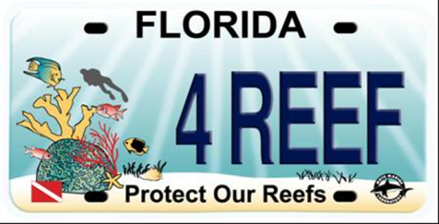
Acknowledgements
NOAA’s Ocean Acidification Program
Mote “Protect Our Reefs” Grants
Notes:
Funding from NOAA’s Coral Reef Conservation Program made this project possible. NOAA’s Ocean Acidification Program has also been very generous to this research. Mote’s protect our Reefs license plate grants provided the initial seed funds to get this project off the ground.

